Slide 1
Applied Data Science Capstone Project
Restaurant Recommendation System
By:
Sahil

Slide 2
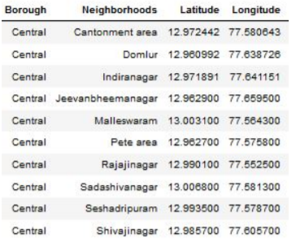
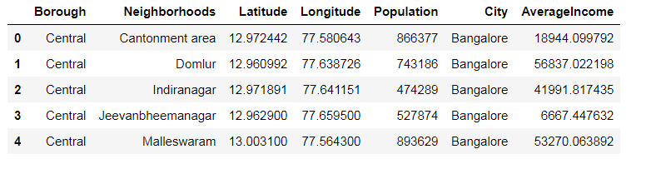
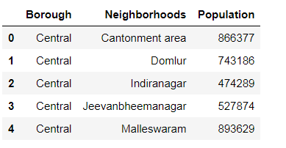
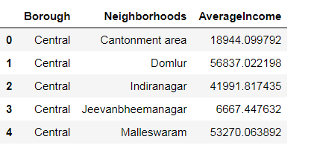
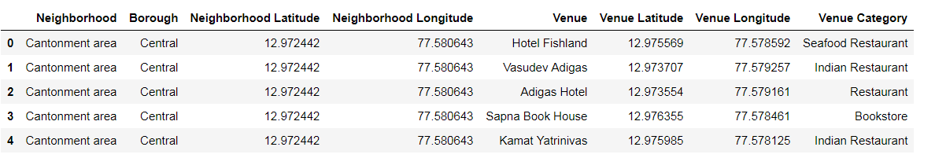
Datasets

Slide 3
Methodology
Exploratory Analysis
Elbow graph for optimal ‘k’
Interferential Analysis

Slide 4
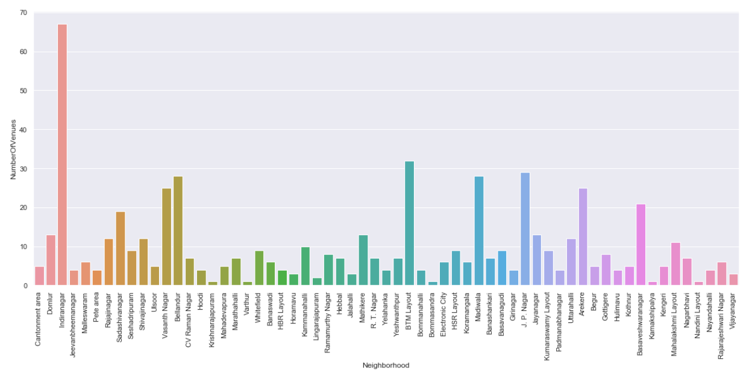
Methodology- Exploratory Analysis

Slide 5
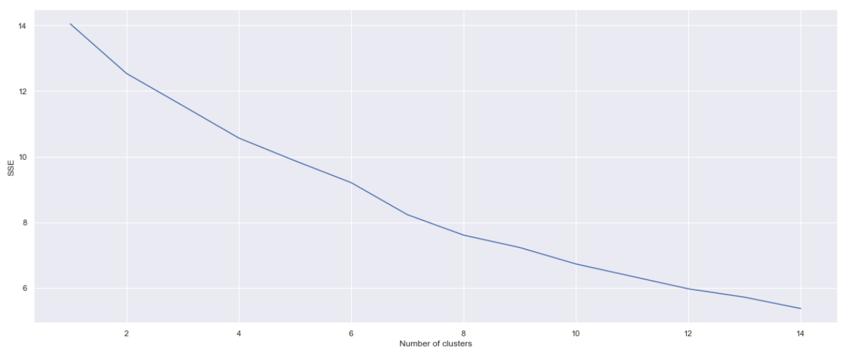
Methodology- Elbow graph for optimal ‘k’

Slide 6
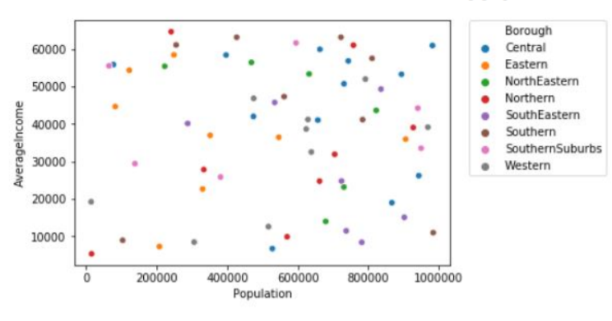
Methodology- Inferential Analysis

Slide 7
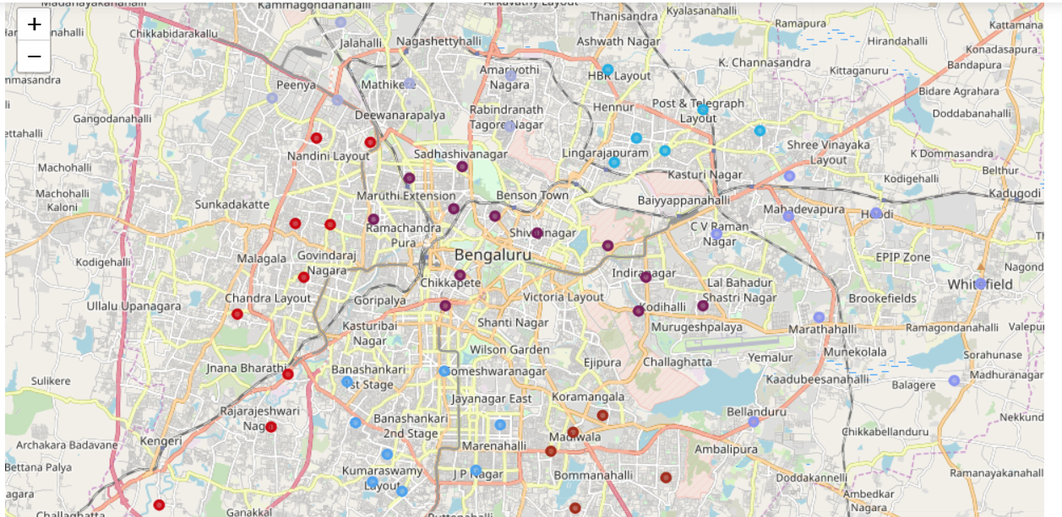
Map of Bangalore

Slide 8
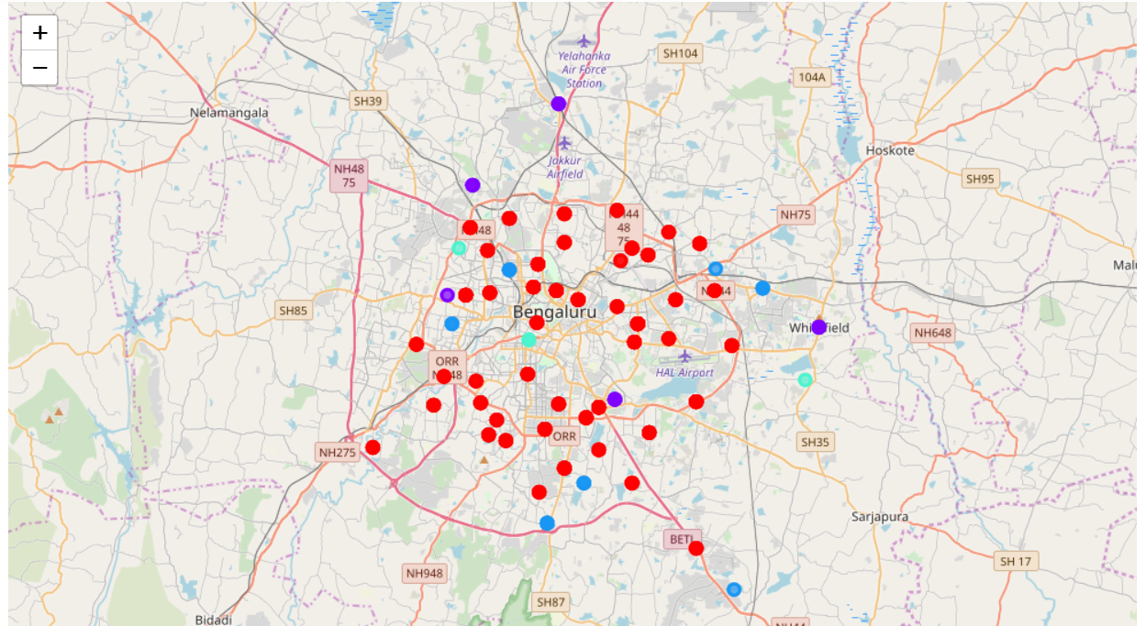
Clustered map of Bangalore

Slide 9
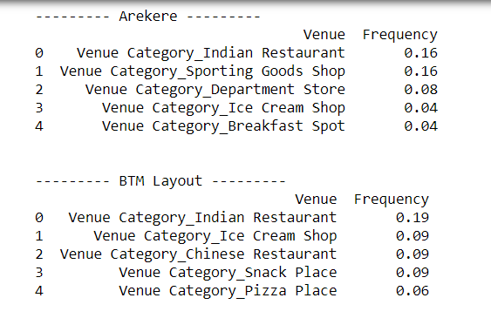
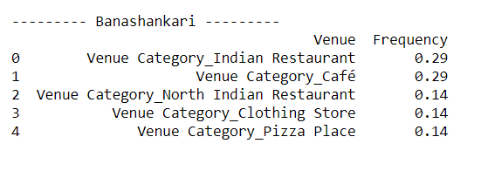
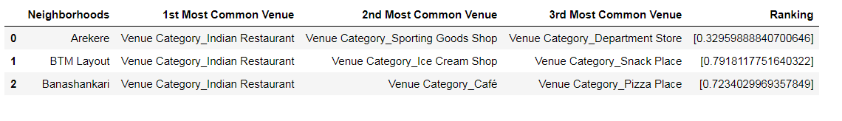
Results and Conclusion

Slide 10
Thank You

